Slide 1
Task 1
Web Scraping to gain company insights

Slide 2
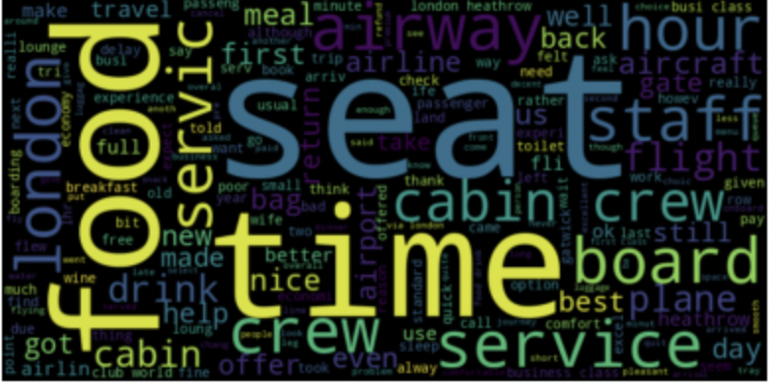
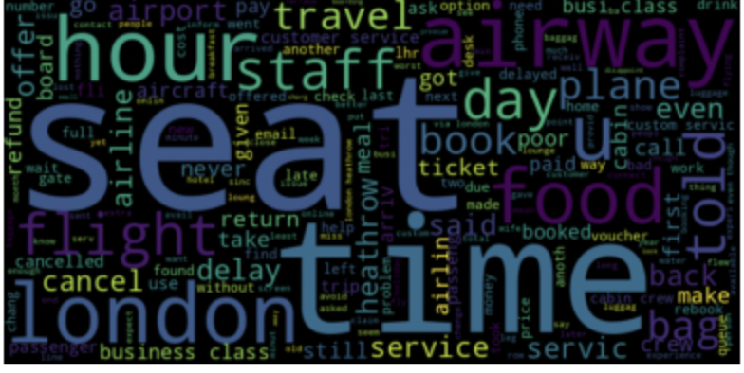
Insights
Our strategy involved performing sentiment analysis on the comments in order to classify them as either positive or negative statements.
With this information in hand, we looked to discover which components of BA were discussed more frequently in the aforementioned categories.
We represented this using the python Library wordcloud.
For instance, the word "Food" is substantially larger in the Positive Word Cloud since it was used more frequently in the positively rated comments.
Positive Word Cloud
Negative Word Cloud

